Slide 1

Welcome to Your Union!
#OURVOICEOURUNION
#WEARECTA
Insert Chapter Name/Logo Here
August 2023

Slide 2
part of a legacy of California educators working together…
YOUR MEMBERSHIP IS
For 160 years CTA members have advocated for educators and students to ensure every person has access to a free quality public education in California. Our successes include:
1867
1913
1915
1927
Access to public schools for all students
Retirement with dignity
Ending child labor in California
Preventing pregnancy firings

Slide 3





YOUR MEMBERSHIP IS
your opportunity to help build a more just and equitable society…
As a member, you begin your own journey and place your personal stamp on our history of advocacy:
1944
1988
1993
2005
Equity for Japanese-Americans interned during WWII
Protecting public school funding through Prop. 98 funding guarantees
Defeating Prop. 174- vouchers would allow public funding of private schools
Battling Governor Schwarzenegger ‘s
Prop. 74 attack on educator employment rights

Slide 4


Your Journey…
…will become your legacy. What part will you play in our progress toward greater equity, access and fairness for all California’s students?
2011
Supporting the DREAM Act to ensure undocumented students can pursue education in the U.S.
2017
Supporting the nationwide
#Red4Ed Movement and the fight
for fundamental services for our public schools

Slide 5
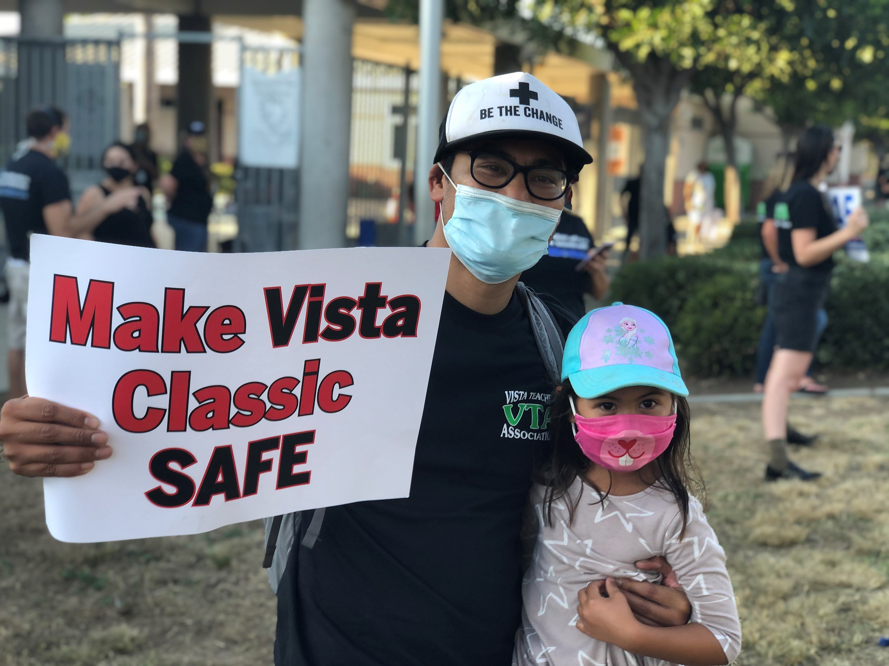
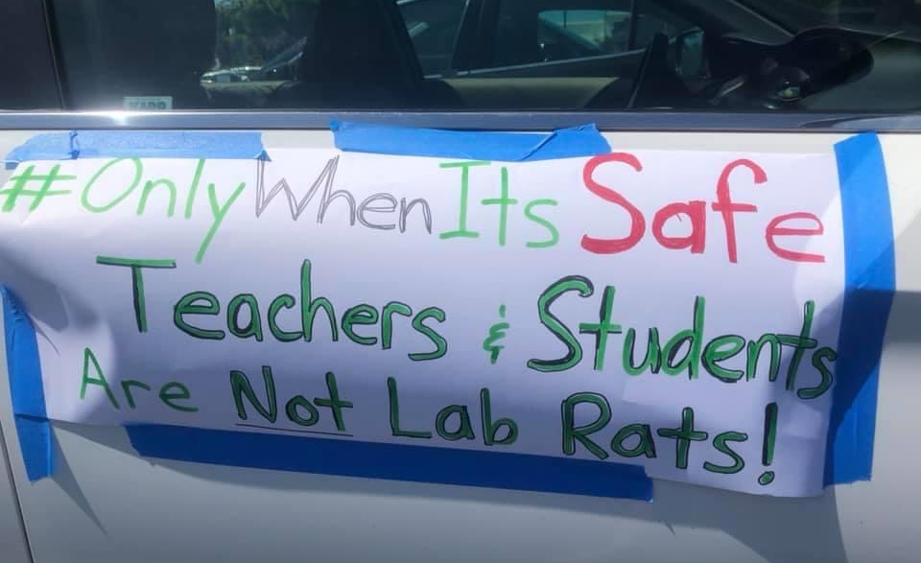
2020-2021
Our members stood with students and parents during the pandemic.
As COVID-19 spread, leaders in local chapters fought to ensure teachers and students would remain in online learning until it was safe to return to schools. CTA’s willingness to defend this safety measure was critical to the safety and well-being of our students and communities.

Slide 6
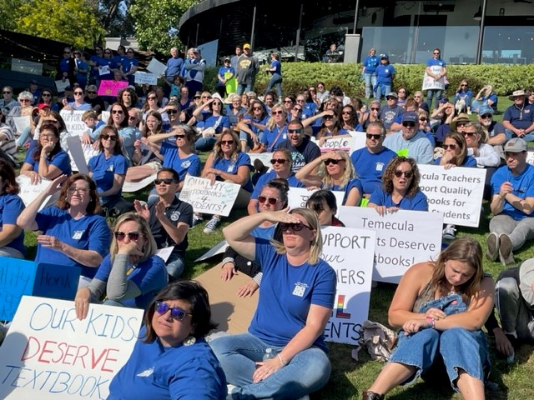
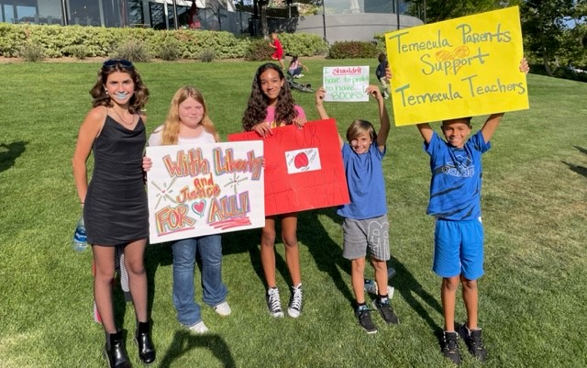
2022-2023
As extremist groups target school boards, members stand strong!
As extremist, anti-union think tanks unveiled attacks against truthful telling of history in education by educators and support staff. Our members have joined with local communities to fight back through protests, rallies, and filing lawsuits to ensure students have access to an accurate history that will ensure strong future citizens.

Slide 7

Education and Social Justice Issues

Slide 8



CTA stands with its movement
partners against racism and bigotry
We believe Black Lives Matter and will continue to support the Asian Pacific Islander community who are currently facing increased discrimination and attacks.

Slide 9
Strengthening
Our Collective
Power
We believe that highly-skilled professionals should receive a professional wage. Our staff has the resources to help local negotiators achieve a fair wage and healthcare benefits for all members.

Slide 10

Professional Growth Opportunities
Improve your professional skills at the Good Teaching Conference, New Educator Weekend, or other conferences and trainings offered on the NEA/CTA calendar each year. Visit CTA.org/events for more information.
CTA’s Instruction and Professional Development department offer trainings in the areas of standards, assessment, curriculum and instruction, Special Ed., social emotional learning, English learners, teacher accountability and teacher evaluation.

Slide 11

CTA Access to Savings
CTA Access to Savings is an
exclusive benefit for CTA members! Featuring the nation’s largest private discount network. Find savings up to 50% on travel
and entertainment, along with everyday things like food, clothing, car care, even home and garden supplies. In fact, use the program regularly and you’ll save enough to offset the entire cost of your dues!

Slide 12
Insurance and Long-Term Savings
While your local chapter negotiates salary and healthcare, your membership is your gateway to savings on discounted auto, home and insurance programs. Loans for autos, personal and home loans are available. Retirement planning should begin as soon as possible. Calculators and tools can assist you whatever your age.

Slide 13
[Insert Local] worked to improve the conditions of teaching and learning locally
Insert bulleted local achievements here:
[Insert local success]
[Insert local success]

Slide 14

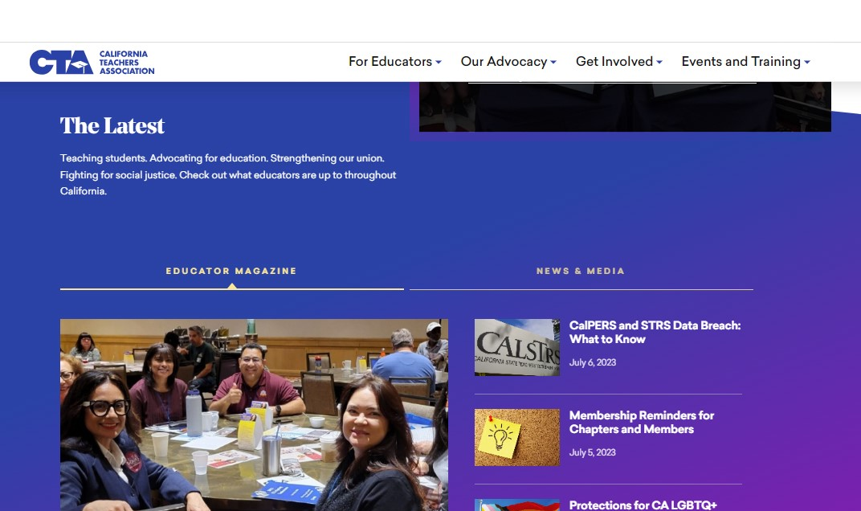

Join Us!
CTA and NEA Resources:
cta.org
ctamemberbenefits.org
nea.org
neamb.com
Connect with CTA & Fellow Members:

Slide 15




