Slide 1

WELCOME TO YOUR UNION!
Three Associations.
One Movement.
#OURVOICEOURUNION
#WEARECTA
Insert Chapter Name/Logo Here

Slide 2
The Beginning of
Your Professional Journey…
YOUR MEMBERSHIP IS
For nearly 160 years CTA members have advocated for educators and students to ensure every person has access to a free quality public education in California. Our successes include:
1867
1913
1915
1927
Access to public schools for all students
Retirement with dignity
Ending child labor in California
Preventing pregnancy firings

Slide 3





YOUR MEMBERSHIP IS
Is your opportunity to help build a more just and equitable society…
As a member you begin your own journey and place your personal stamp on our history of advocacy:
1944
1988
1993
2005
Equity for Japanese-Americans interned during WWII
Protecting public school funding through Prop. 98 funding guarantees
Defeating Prop. 174- vouchers would allow public funding of private schools
Battling Governor Schwarzenegger ‘s Prop. 74 attack
on educator employment rights

Slide 4


Your Journey
will become your legacy… What part will you play in our progress toward greater equity, access, and farness for all California’s students?!
2011
Supporting the DREAM Act to ensure undocumented students can pursue education in the U.S.
2017
Supporting the nationwide #Red4Ed Movement and the fight for fundamental services for our public schools

Slide 5
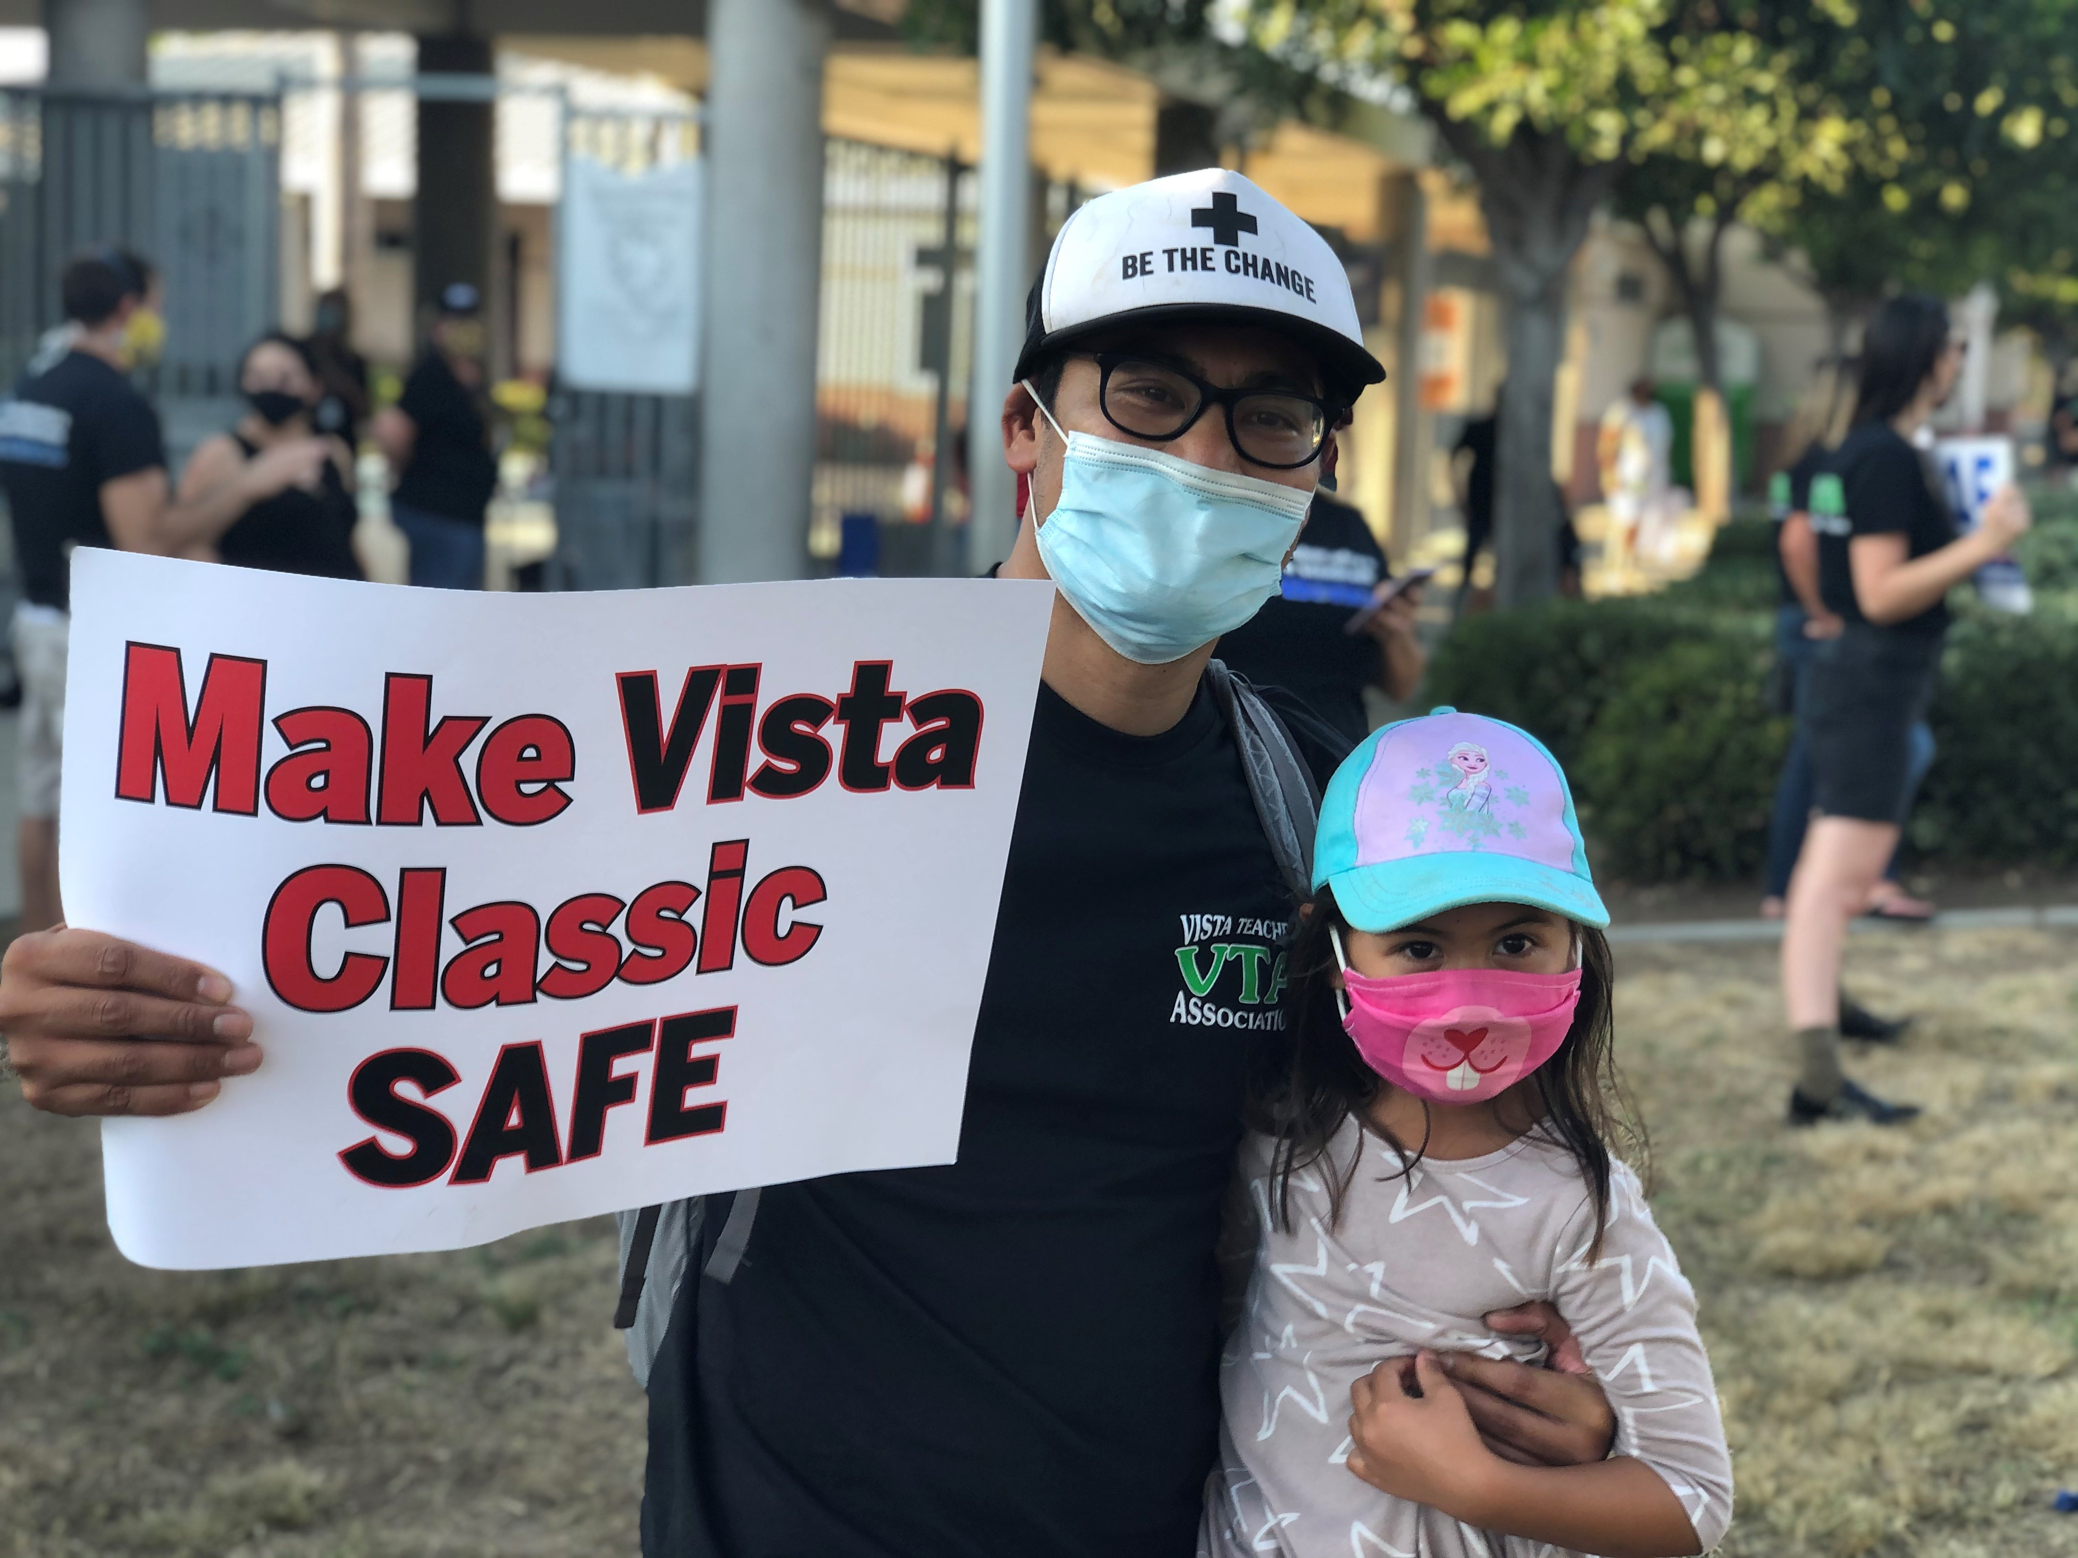
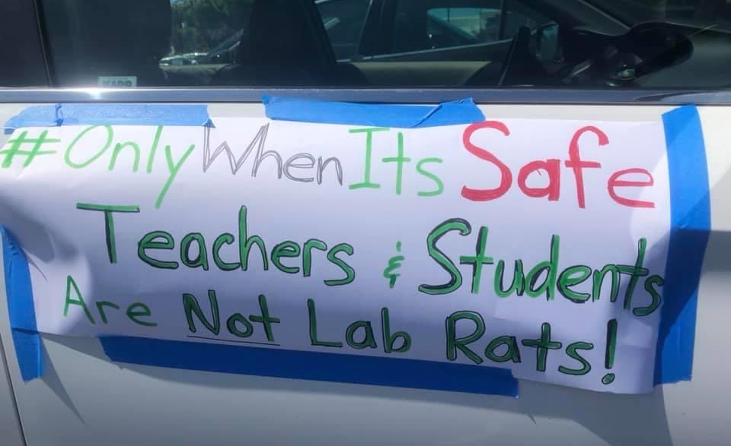
2020-21
Our members stood with students and parents during the pandemic
As COVID 19 spread to the U.S. leaders in local chapters fought to ensure teachers and students would remain in online learning until it was safe to return to schools. CTA’s willingness to defend this safety measure has saved countless lives.

Slide 6
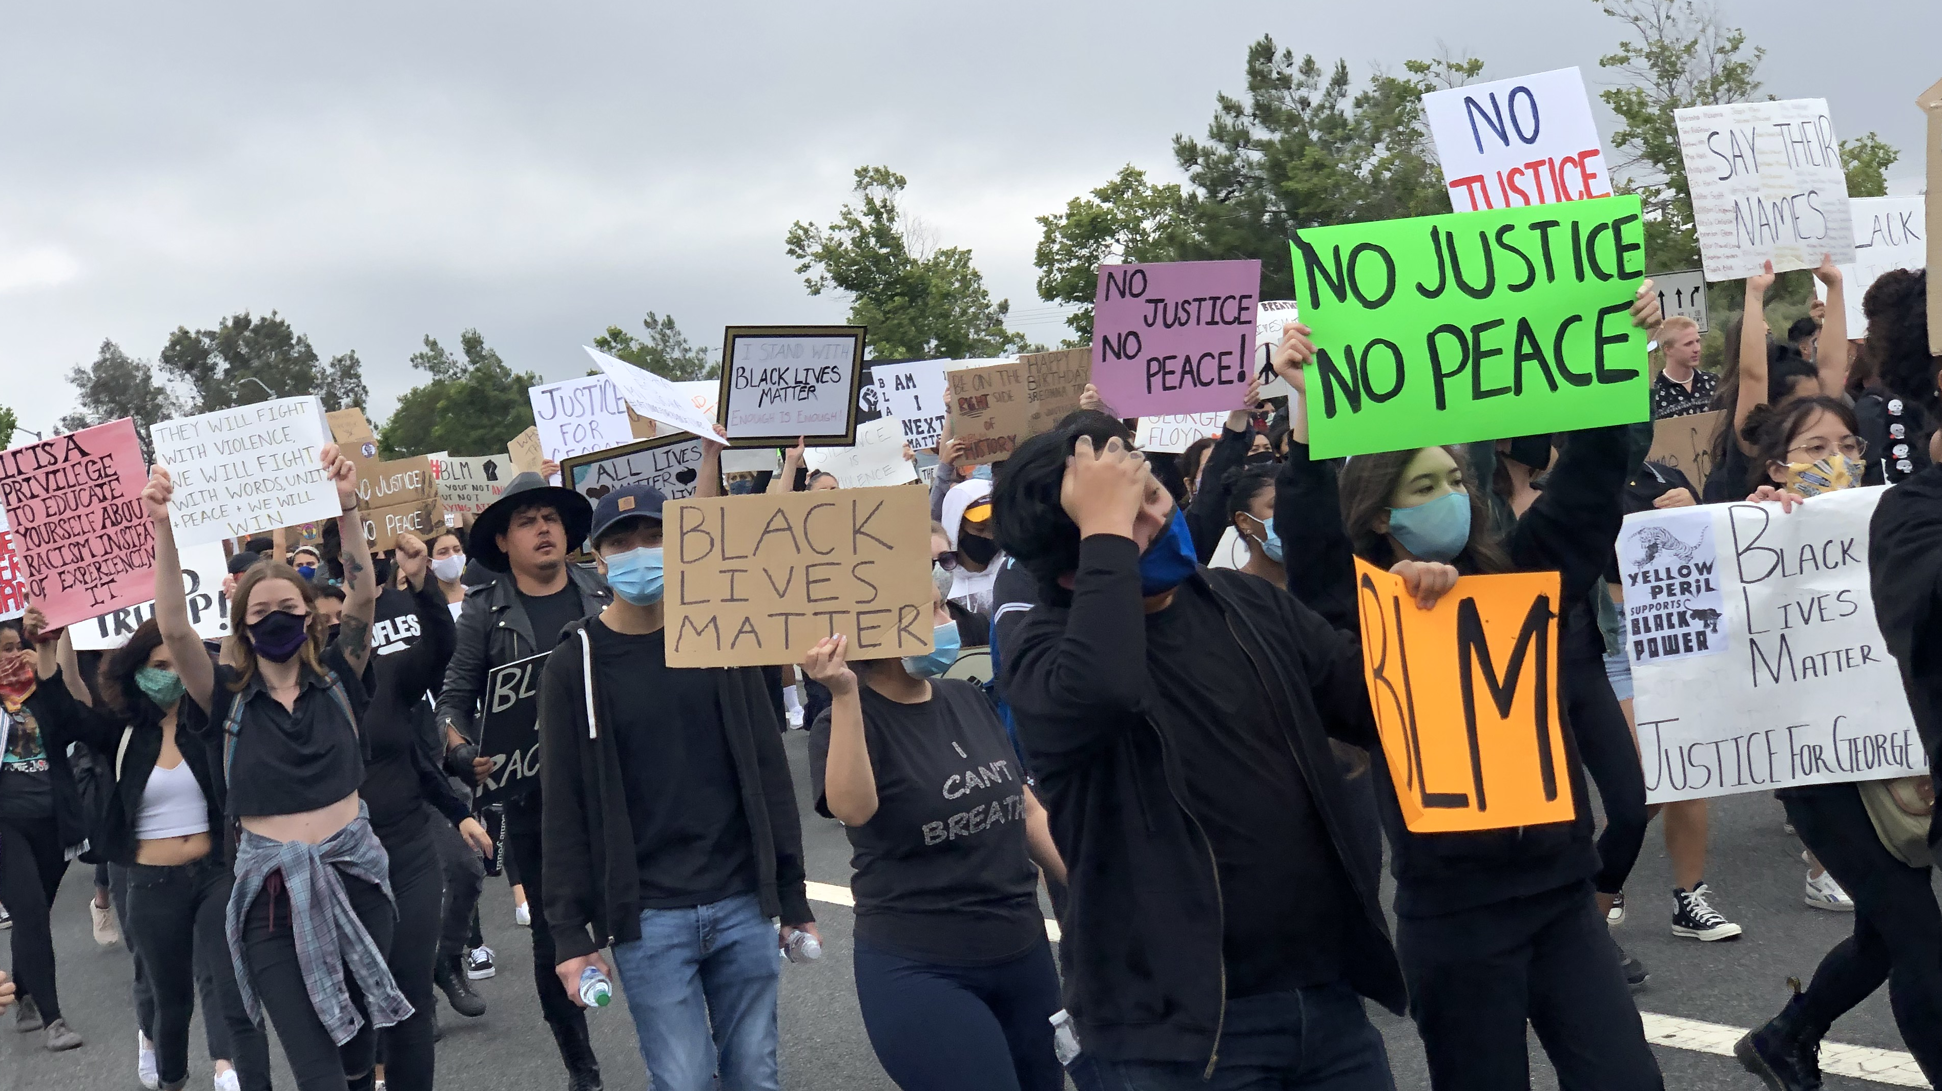
Education and Social Justice Issues
YOUR VOICE ON LOCAL, STATE, NATIONAL
Local leaders and staff provide support around bargaining, member engagement, and social justice organizing issues. Our Sacramento and Washington D.C. teams monitor legislation that keeps educators informed about policies as it provides resources to influence public policy.

Slide 7
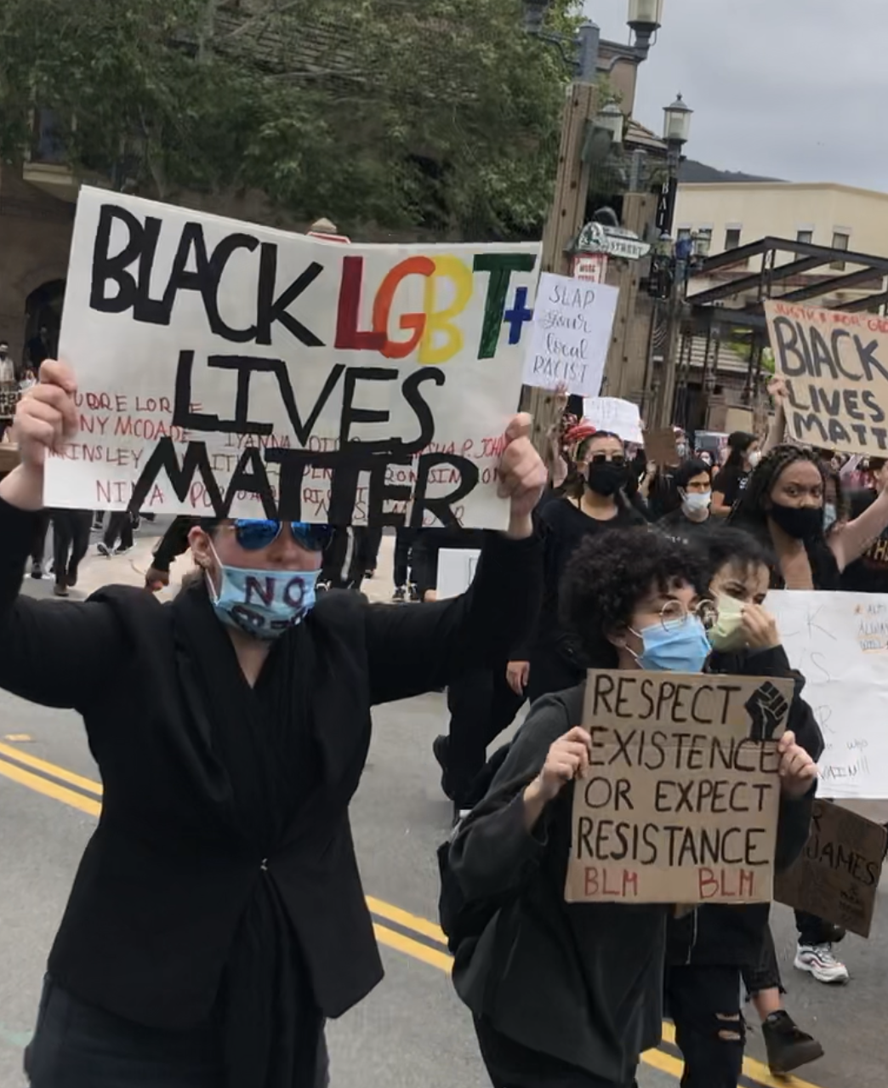


CTA stands with its movement
partners against racism and bigotry
We believe Black Lives Matter, and will continue to support the Asian Pacific Islander community who are currently facing increased discrimination and attack

Slide 8
Strengthening
Our Collective Power
We believe that highly-skilled professionals should receive a professional wage. Our staff has the resources to help local negotiators achieve a fair wage and healthcare benefits for all members.

Slide 9

Professional Growth Opportunities
Improve your professional skills at the Good Teaching Conference, New Educator Weekend, or other conferences and trainings offered on the NEA/CTA calendar each year. www.CTA.org/events
CTA’s Instruction and Professional Development group gives virtual trainings in the areas of standards, assessment, curriculum and instruction, Sp Ed., Social emotional learning, English learners, teacher accountability, and teacher evaluation.

Slide 10

CTA Access to Savings
CTA Access to Savings is an exclusive benefit for CTA members! Featuring the nation’s largest private discount network. Find savings up to 50% on travel, entertainment, along with everyday things like food, clothing, car care, even home and garden supplies. In fact, use the program regularly and you’ll save enough to offset the entire cost of your dues!

Slide 11
Healthcare, Insurance, and Long-Term Savings
While your local chapter negotiates salary and healthcare, your membership is your gateway to savings on discounted auto, home, and insurance programs. Loans for autos, personal- even home loans are available. Retirement planning should begin as soon as possible. Calculators and tools can assist you whatever your age.

Slide 12
[Insert Local]worked to improve the conditions of teaching and learning locally
Insert bulleted local achievements here
[Insert local success]
[Insert local success]

Slide 13
Resources
Connect to CTA & Fellow Members:
CTA
CTA Member Benefits
CTA Invest
NEA
NEA Member Benefits

Slide 14




