Slide 1
CTA 360 APP ENROLLMENT

Slide 2
AVAILABLE CTA 360 APP ENROLLMENTS
NEW CTA Active Members
User will create an individual profile and add the new Active Membership with the member present to sign electronically directly on the app.
Active member enrollments for K12 and CCA currently available.
NEW CTA Non-Member Potential
User will create an individual profile and add the new Non-Member Potential record directly on the app. (Individual need not be present since no signature is required)
CONVERTING Non-Member Potential to Active Member
User will find the current Non-Member Potential records and convert their membership to Active Member with the member present to sign electronically directly on the app.

Slide 3
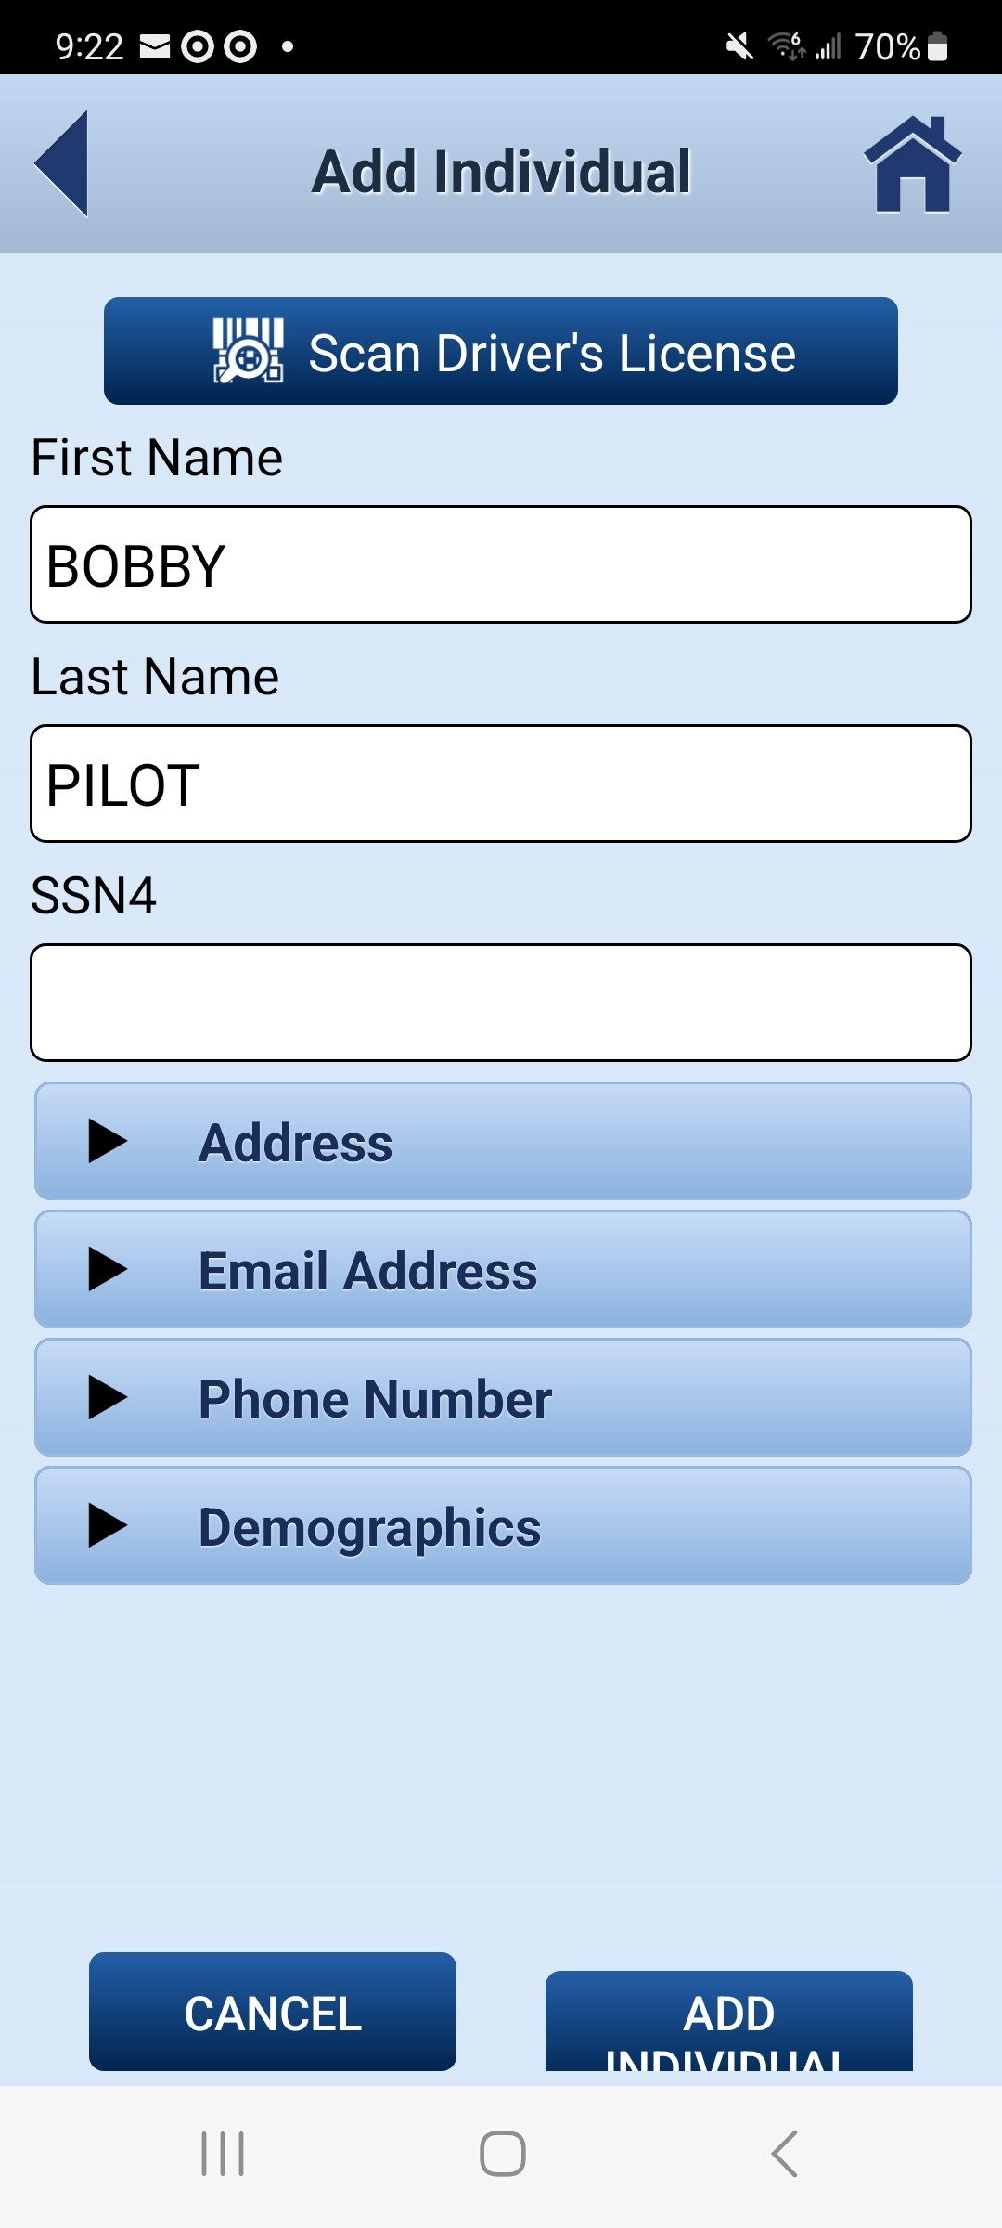
CTA 360 ENROLLMENT
Individual Contact Information
An individual profile, including contact information, must be in Falcon prior to enrolling the individual as an Active Member or Non-Member Potential

Slide 4
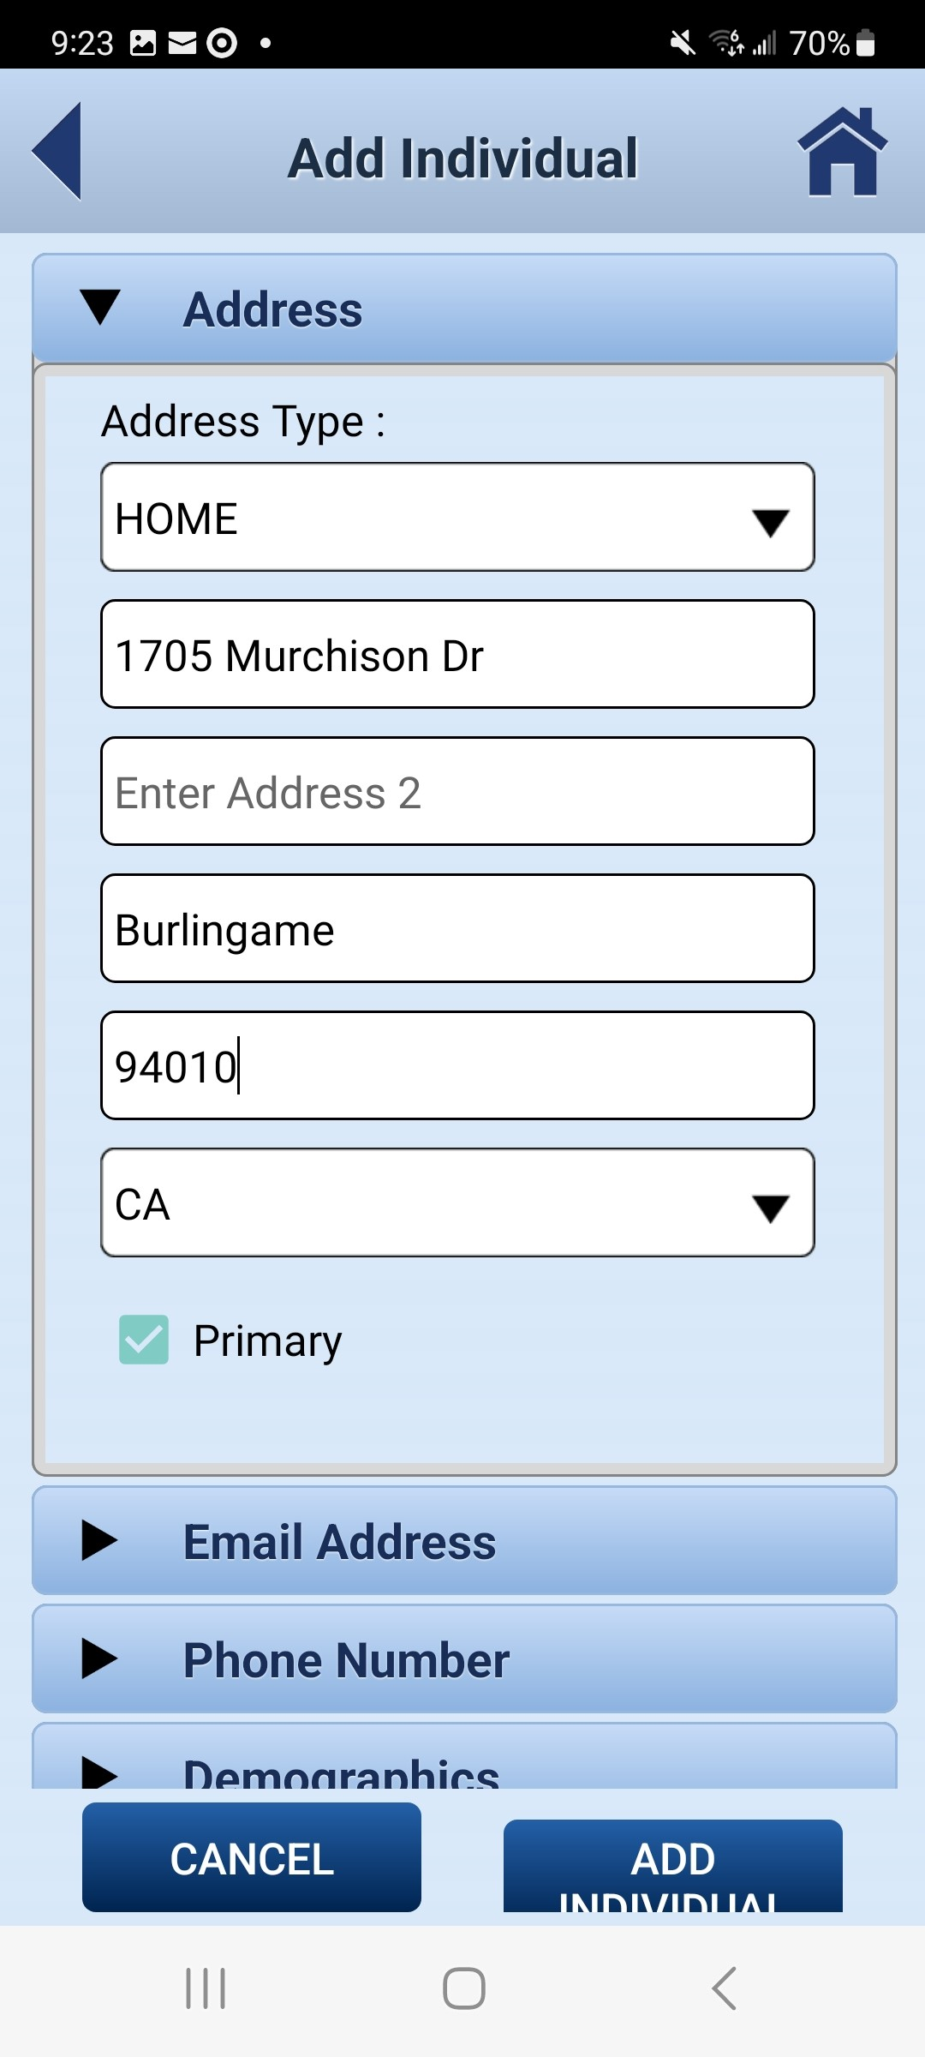
CTA 360 ENROLLMENT
Individual Contact Information
The individual’s HOME contact information is preferred when adding the profile into Falcon. Areas where multiple types of information can be entered, the member can designate which information is marked as primary.

Slide 5
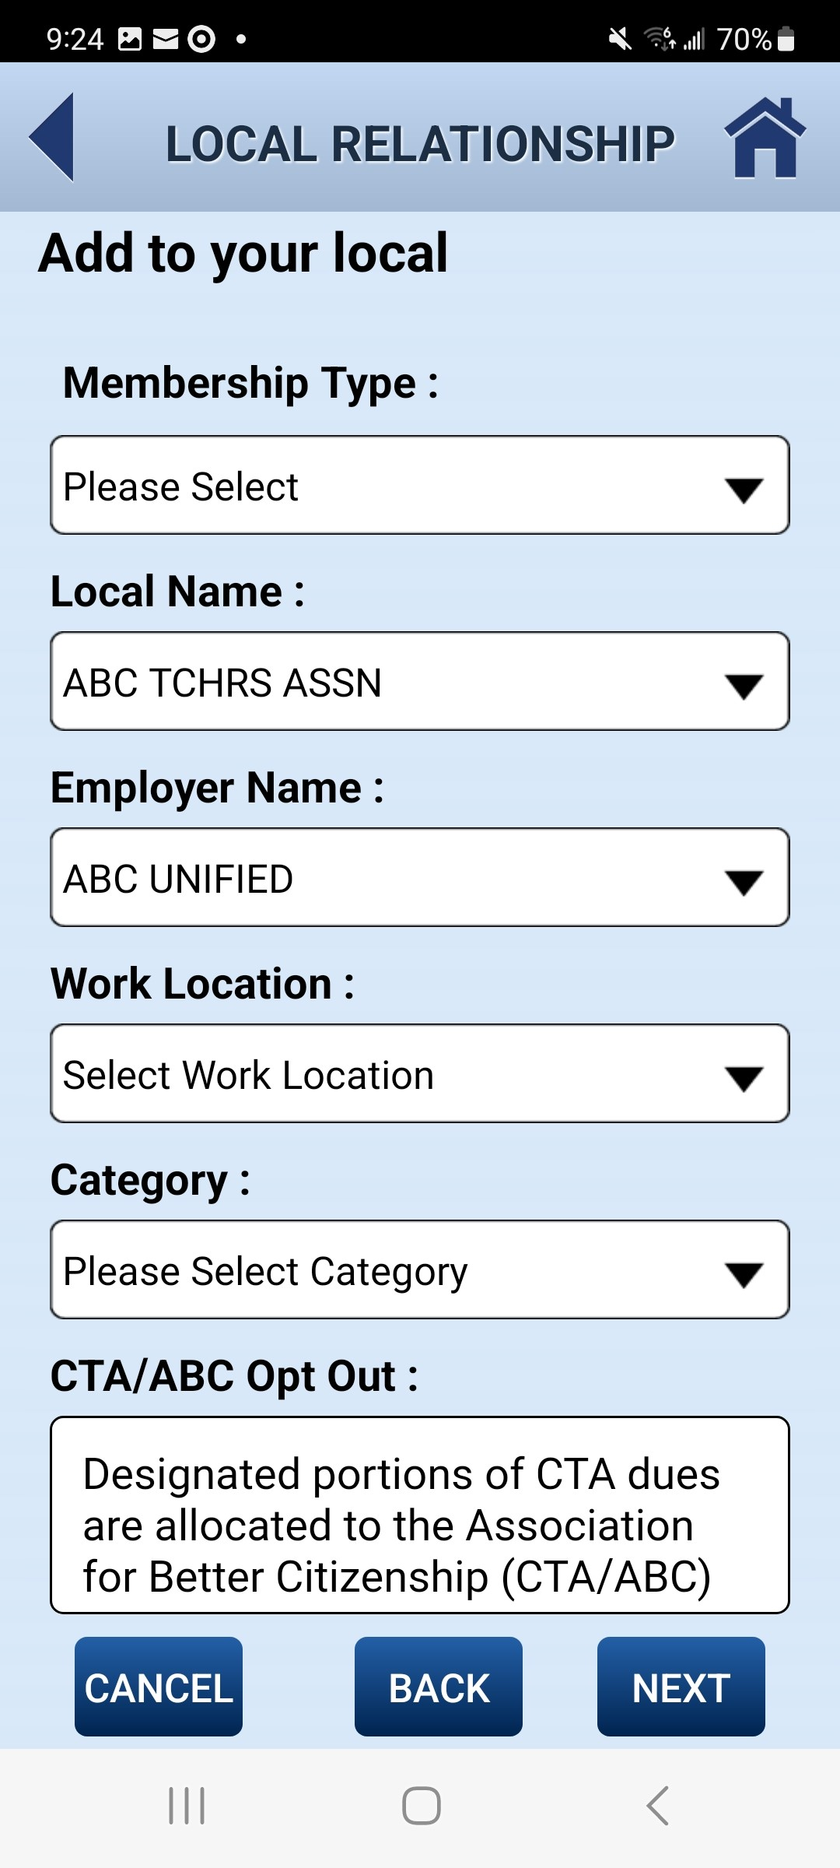
CTA 360 ENROLLMENT
Membership Information
Once an individual’s contact information is confirmed,
the membership information, Local, Employer and Work Location is selected from the drop-down options.

Slide 6
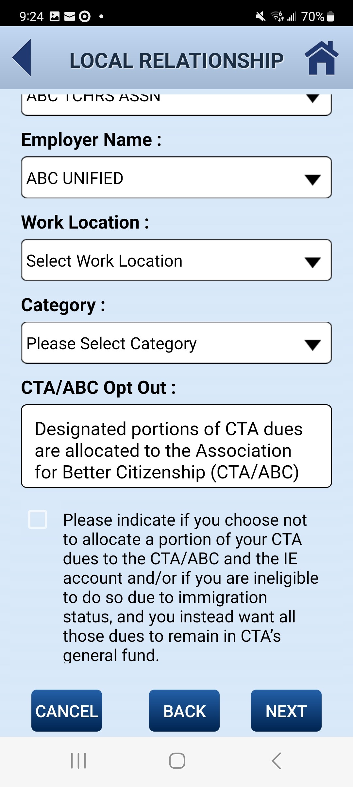
CTA 360 ENROLLMENT
CTA/ABC Opt Out
Along with selecting the Membership Information,
members are informed about CTA/ABC and
have the option to opt out if desired.

Slide 7
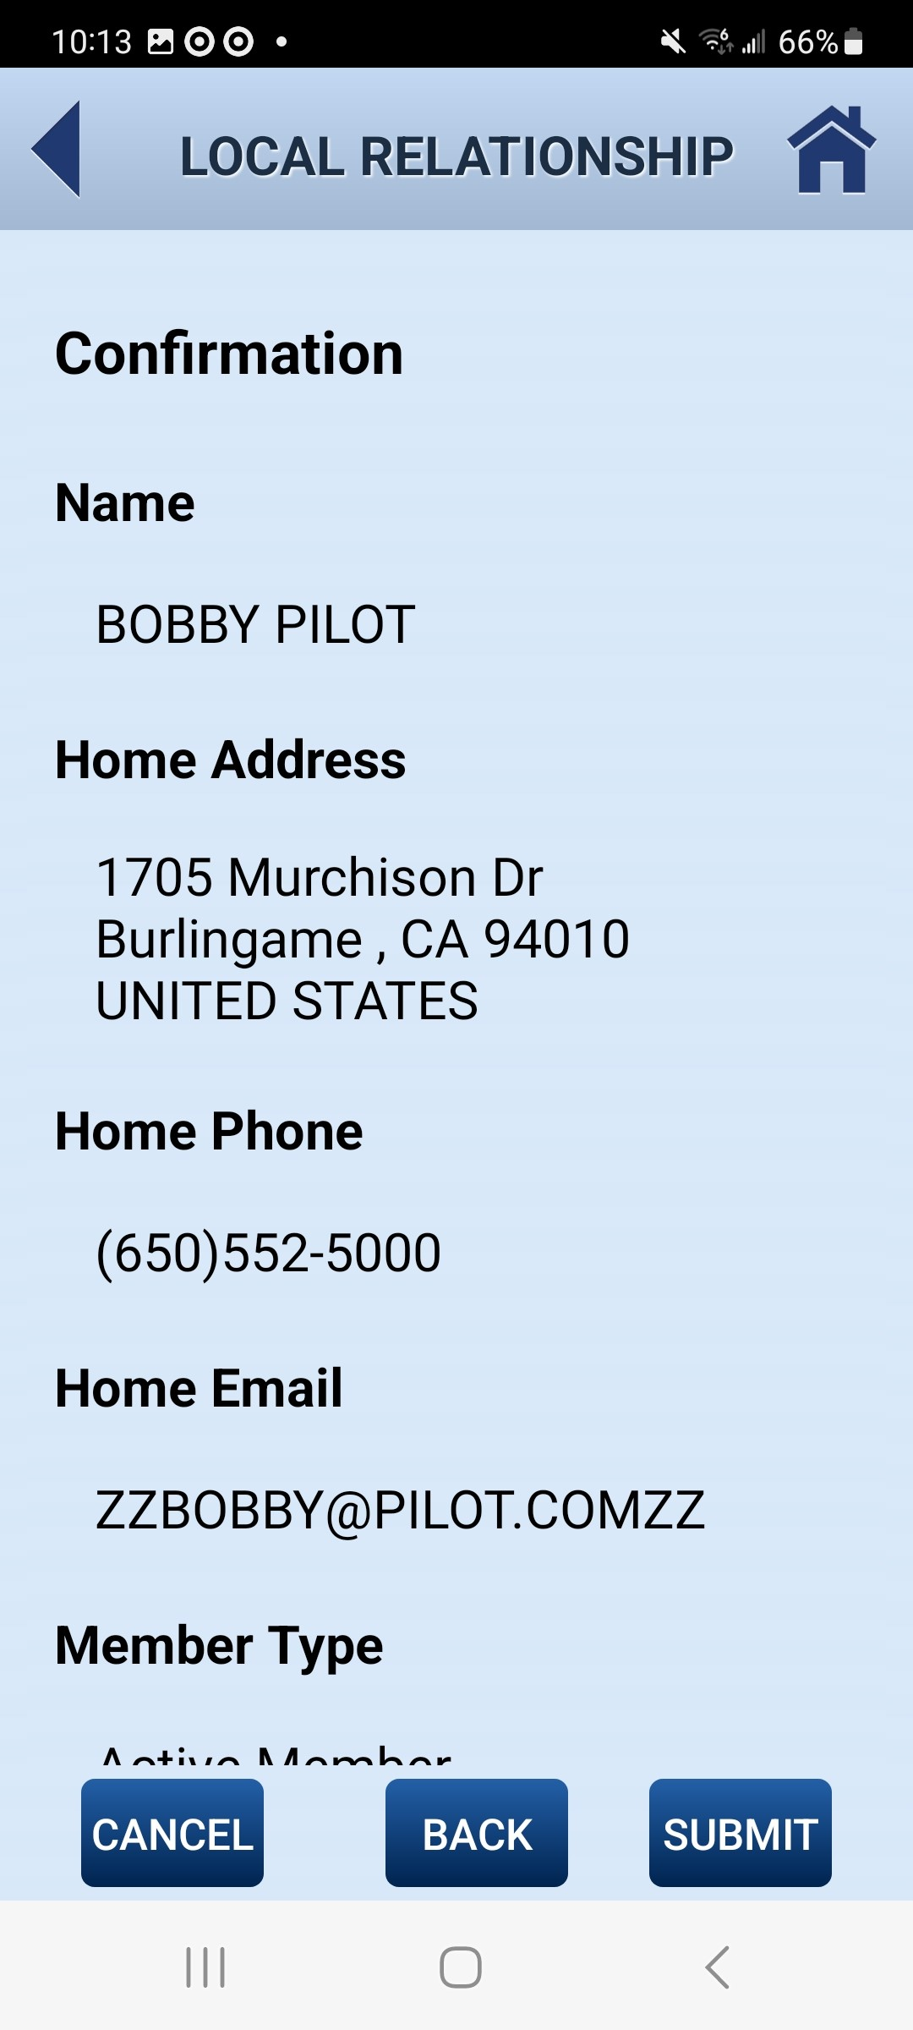
CTA 360 ENROLLMENT
Confirmation
The member should confirm the information that is entered and go back to update any incorrect information before submitting the enrollment.

Slide 8
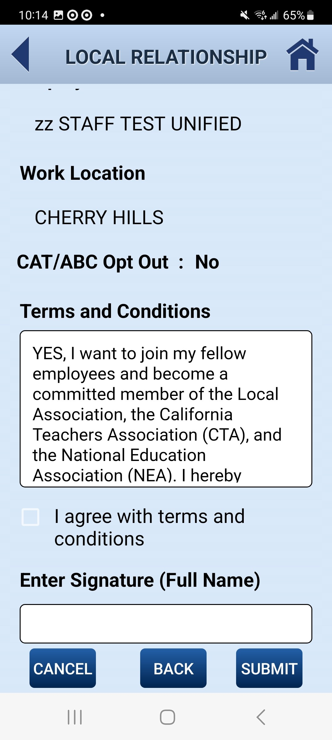
CTA 360 ENROLLMENT
Submit Enrollment
Scrolling down the confirmation page, the member
must also read the CTA Membership Terms & Conditions
and sign electronically directly on the app
before submitting the enrollment.

